Slide 1
Going Serverless with Chalice
A Python Serverless Microframework
@RoselleEbarle
Notes:
I’m roselle, and i work as a software engineer for web mavens, a company based in india. We work with clients from the US, and I’m here to talk about going server less with chalice.
Going server less has been a relief considering that i’m their first dev here in the philippines, and i’m responsible in handling both backend and web app development, going server less gives me one less problem to worry about - and that is managing servers. So we’ll talk more about this.
and we are still looking for more people to join our remote team. So if you’re based in cebu or anywhere in the philippines and you want to work from home and avoid not worry about getting late or commuting, please feel free to ping me.

Slide 2
Agenda
1. We are going to build an app
2. How going serverless can help
3. How chalice fits in the puzzle
4. Getting started with chalice
Notes:
In order to get a better understanding of what going server less means, we are going to talk about a scenario / story. We will be receiving a set of reqs, and we’ll examine how sls could potentially meet these reqs.
Then we are going to talk about how chalice fits in the puzzle. As a primer, chalice allows us to deploy our backend code
Then we will have a demo on getting….

Slide 3
1. We are going to build a web app!
Core Requirements
Early Feedback
Budget
Scaling & Performance
Notes:
And suppose we are part of a company. The CEO steps up and then tells us all that today we are going to build a product. So, here are the constraints and requirements:
Startup, Early feedback - We are building a web application, and that we are following lean approaches, so we want to get our minimum viable product or technology in front of an end user as soon as possible in order to get early feedback. Because that’s where value lies, right?
Budget - Now more constraints, we are actually on a tight budget, so we don’t have a lot of hands to work on the project. We prefer devs who can work full-stack and those who can work out the servers and do ops or server management, well that would really be great. So expect around 3-4 hours of sleep everyday, for the first month?
Scaling & Efficiency - This is a really great idea, so for the first launch, we are expecting high traffic volume because we will be announcing really great value and that everyone will be using our app. But expect it to dwindle down from time to time. So we need it be efficient and capable of scaling, but at the same time we also don’t want to invest in too much infrastructure for hosting since going back to our previous constraint, we are on a budget.

Slide 4
1. We are going to build a web app!
Product Components
API Backend
Web Application
*Mobile Application
Notes:
So on a side note i’ve been thinking really hard on what our product would be, so i hope you won’t get disappointed, but we are going to build an on demand laundry service. Because everyone hates laundry day right and sometimes i’d rather do something else than wash my own laundry or deliver it to the laundry shop - but we have to.

Slide 5
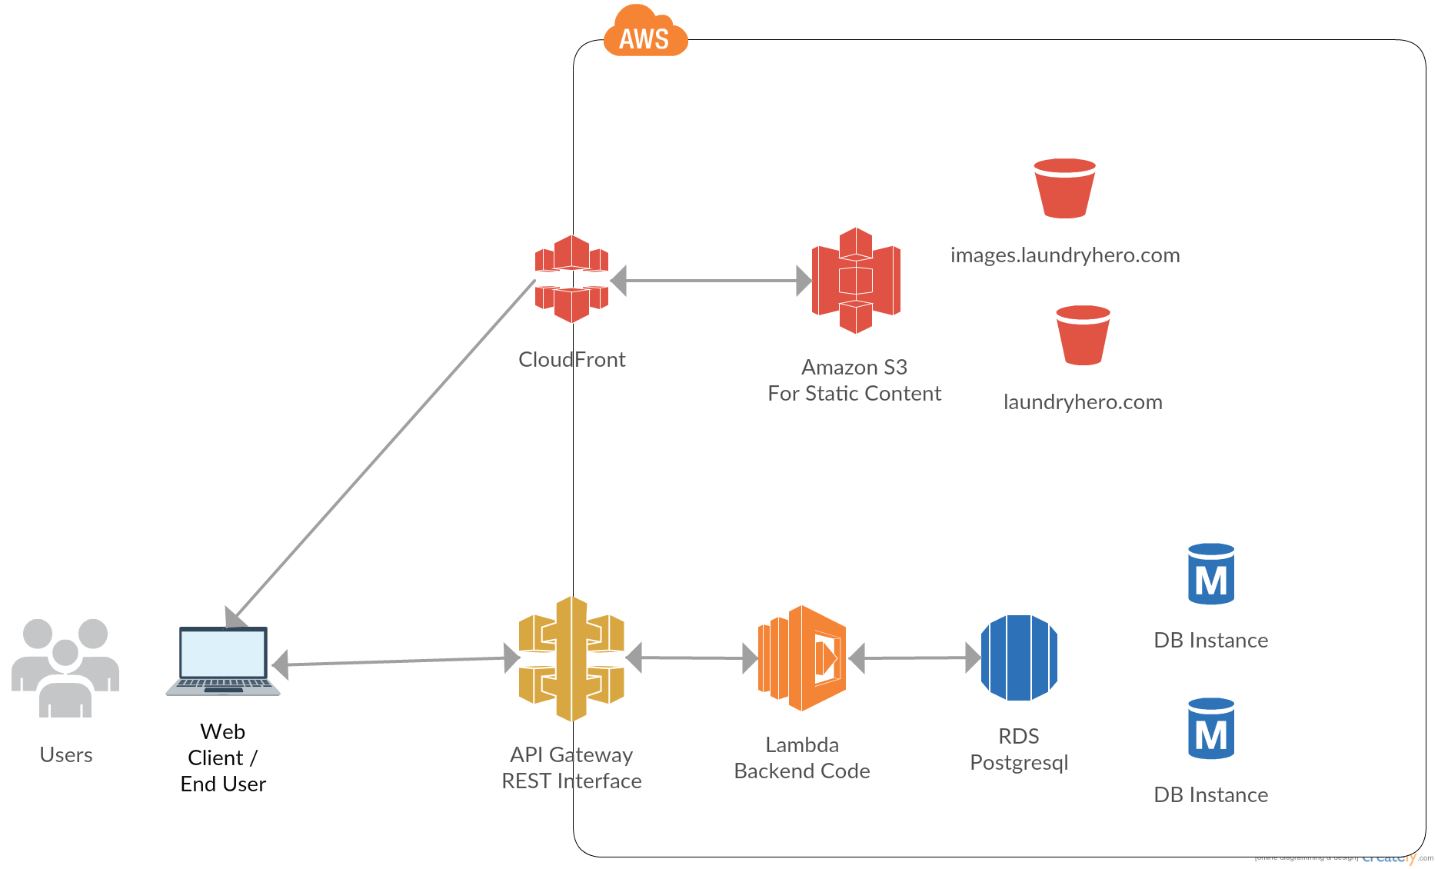
2. How going serverless can help
The High-level Architecture
Notes:
What do you notice? These are products from amazon,
So here’s how our application’s high level architecture will look like.
Amazon S3 bucket is created to store the static web app contents of the application.
API endpoints are created using API Gateway and these endpoints are mapped to Lambda functions. The API Gateway POST method points to a Lambda function. The GET method points to another Lambda function.
AWS Lambda functions are created to serve as the back-end business logic tier for processing the requests - there are a lot of use cases for lambda but today we will be using it as a backend for our application
COMPARE TO EC2
Postgres database will be used to store our data.

Slide 6
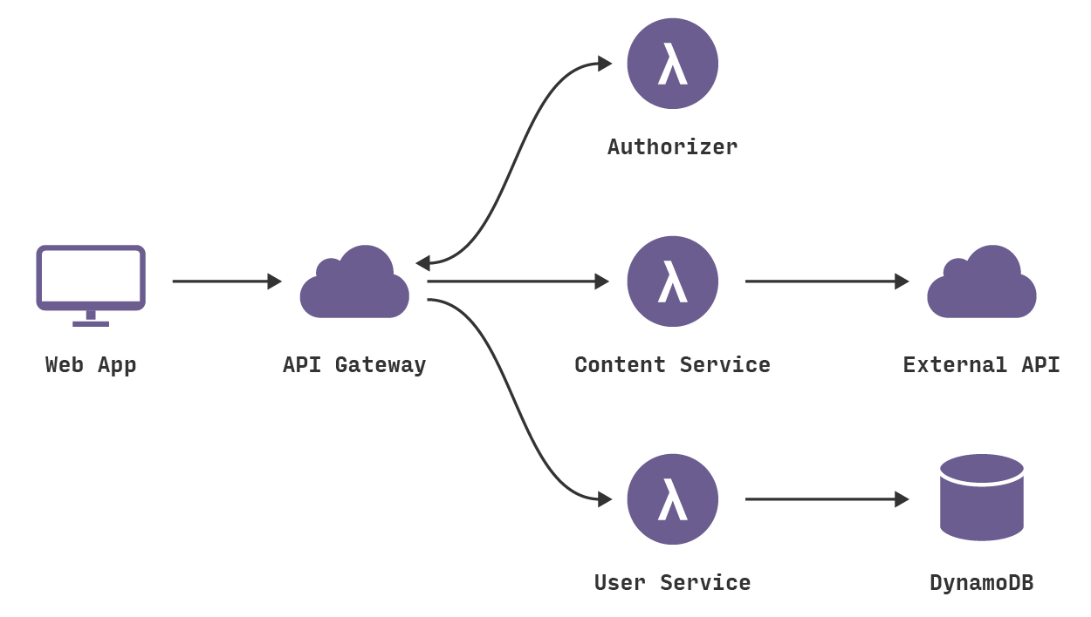
2. How going serverless can help
Source: https://blog.fugue.co/2016-05-05-architecting-a-serverless-web-application-in-aws.html

Slide 7


2. How going serverless can help
API Gateway
AWS Lambda
Notes:
API Gateway
Create, maintain and secure APIs at any scale
Handles authorization, access control and monitoring
Acts as a “front door” for applications
Lambda
Run code without thinking about servers
Pay for only the compute time you consume
500ms i can bear with it, but that’s not a really good user experience
20s to give my response, well that’s very bad. I would have left and thought that your app is broken.
Lambda takes care of everything required to run your code with high availability

Slide 8
2. How going serverless can help
How does this help us?
Budget
Scaling & Performance
Early Feedback
Notes:
If you are the dev, i think it’s time to take a breath now.
But we won’t be building this application today, that would be for another workshop. today we are going to implement a part of this architecture, so we are going to create our first serverless api, and i’ll show you how to deploy it within seconds. And how a python tool / framework actually makes our life easier.
Okay, so even if we have these constraints, management has decided to follow a serverless architecture. With the help of AWS solutions such as: compute, storage and database, we will be building a serverless application.
going Serverless means to build and run applications without thinking about servers or managing our servers.
A serverless application will allow us to bypass the constraints i’ve pointed out earlier, and allow us to focus on our goal - early feedback.
- Budget - So we eliminate the need to worry about budget, because such architecture will allow us to pay only when our code is being executed.
- Scaling & Efficiency - Even if we get a traffic surge of 1M requests the first day, our application will be able to scale - performance is guaranteed, and even if traffic dwindles the next day - little to no traffic, then we won’t worry because we’ll only pay whenever our code is being run.
- Early feedback - now that we only worry about our code and logic, this will allow us to deliver faster. This will allow us to focus on activities that drive business value, and it also results to
These characteristics of a serverless app results to = Happy and productive developers

Slide 9
Demo
Easy! Let’s try to do the API backend then!
Notes:
https://727522671351.signin.aws.amazon.com/console
u: pycon
p; pycon123
lambda
api gateway

Slide 10
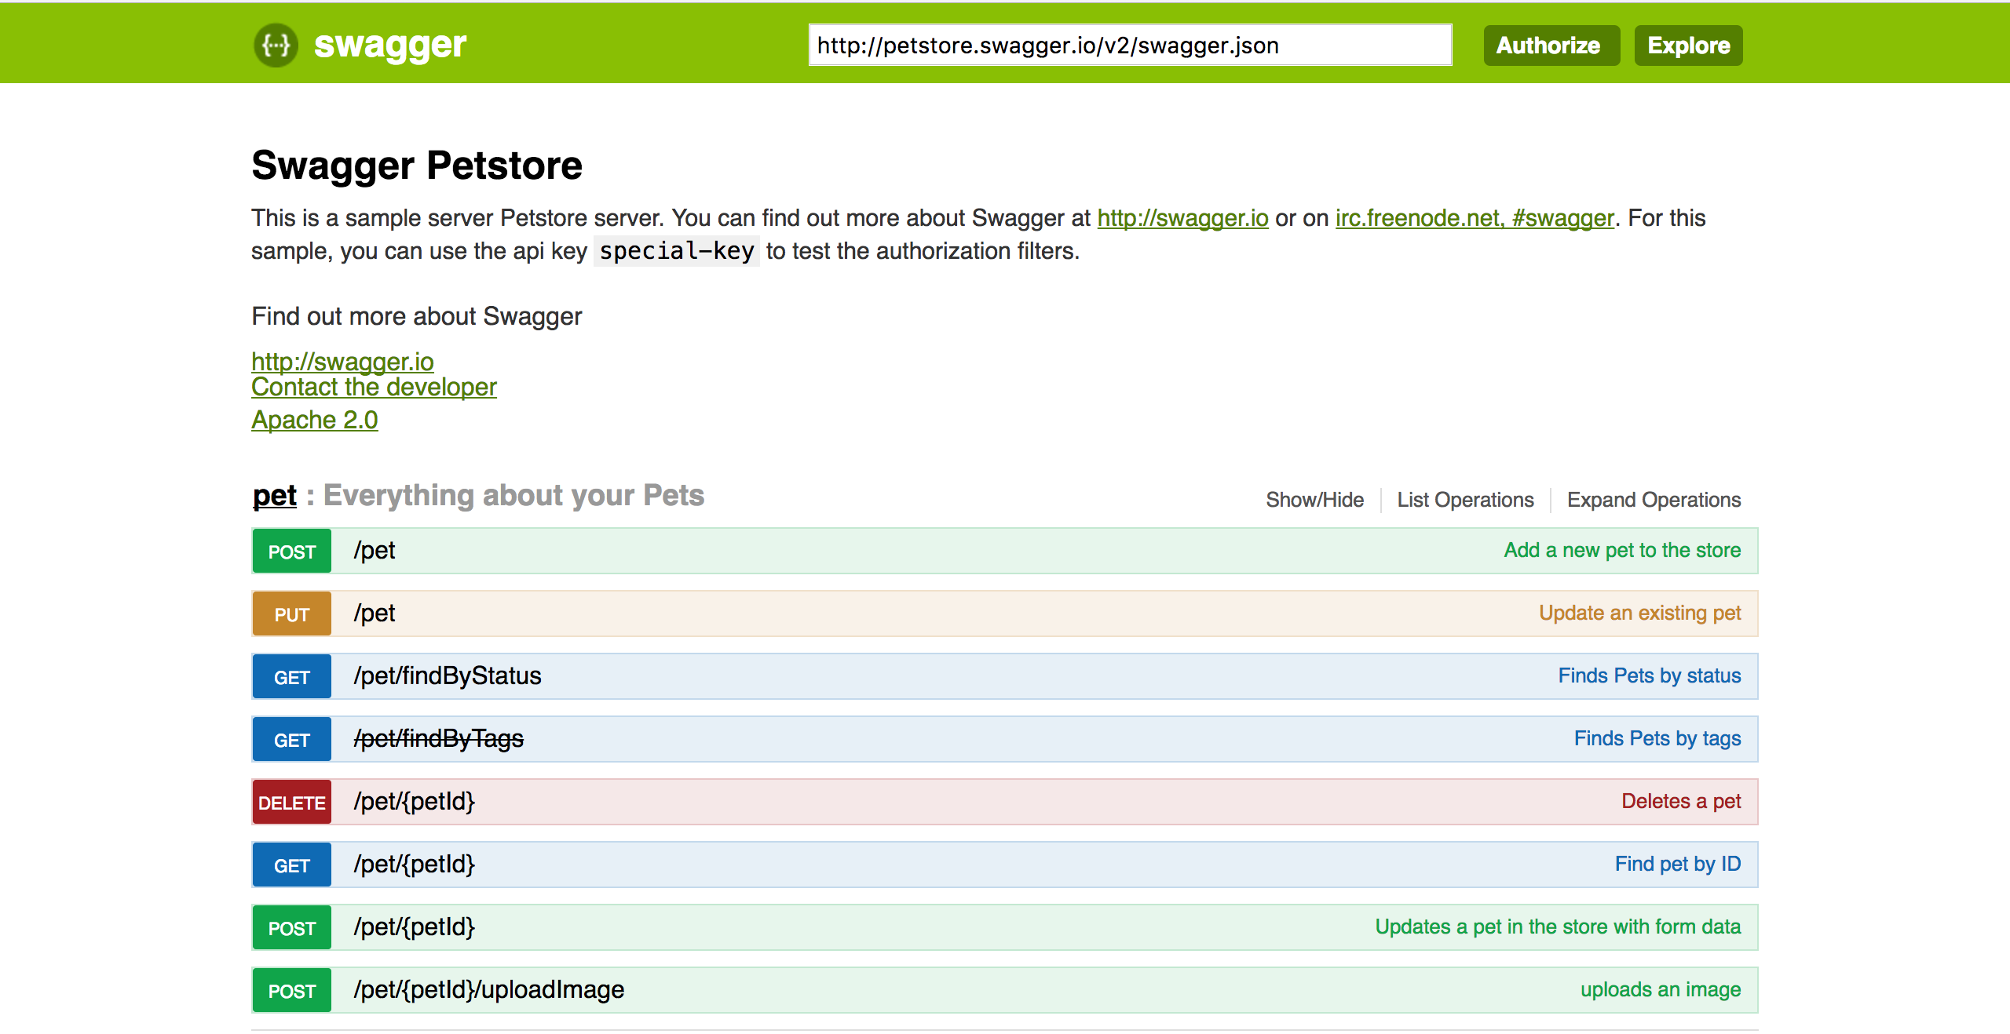
Easy? What if…
Notes:
So, you’ve noticed that we were going back and forth between two different interfaces right? API gateway & lambda. We went to create our code in lambda, and created our endpoints in gateway. But that workflow is good enough if you only had once service - a hello world service without any dependencies.

Slide 11
3. How chalice fits in the puzzle
“The python serverless microframework for AWS, it allows you to quickly create and deploy applications that use Amazon API Gateway and AWS Lambda”
–awslabs
Notes:
Here’s where chalice comes in.
Chalice is a python tool from awslabs, built by aws developers themselves. Chalice will make our life easier, and allow us to create and deploy our api within seconds.
I know there’s a lot of components, but chalice is a tool that will help us create and deploy our apis for our application that is hosted in our s3 buckets.
Output: hello world api

Slide 12
3. How chalice fits in the puzzle
It provides:
A command line tool for creating, deploying, and managing your app
A familiar and easy to use API for declaring views in python code
Automatic IAM policy generation
Notes:
Will it really help us?

Slide 13
Demo
4. Getting started with chalice
Notes:
services:
- users

Slide 14
Summary
Amazon Ecosystem (API Gateway & Lambda)
Basic Serverless Architecture
Python tool - Chalice
Opportunities vs Cost
Alternatives
Notes:
1. Amazon API gateway and AWS Lambda - So today, we discussed one of the many use cases or lambda, and api gateway.
2. Basic Serverless Architecture - We also learned a really basic architecture of a serverless application - we only had around 5 components right? That’s not the end of it.
3. Advantages of a serverless application - We’ve learned how going serverless allows us to get rid of problems such as server management, scaling, budget & efficiency.
We’ve acknowledged the opportunities but i don’t think i’ve mentioned the costs. At the end of the day, we’ll always reflect on our goals, and requirements. Going serverless is not all unicorns and rainbows because for example, we give up management and control over cost reduction. Eliminate operational complexity at the expense of vendor lock in, or the immaturity of tools.
- Alternatives - It’s good to know that there are other vendors in the market that provides us with infrastructure or solutions in building serverless applications, and there are also other tools,

Slide 15

Questions?
Thank you for your time!
Slides and demo available at http://bit.ly/2my06hQ

